Slide 1


BACKGROUND
CONTRACT
WEB CLIENT

Slide 2

Web3.js
Official Ethereum JavaScript API
Use to interact with Ethereum smart contracts.
Use to read and write to The Ethereum Blockchain.
Can be used to deploy smart contracts.
.js

Slide 3
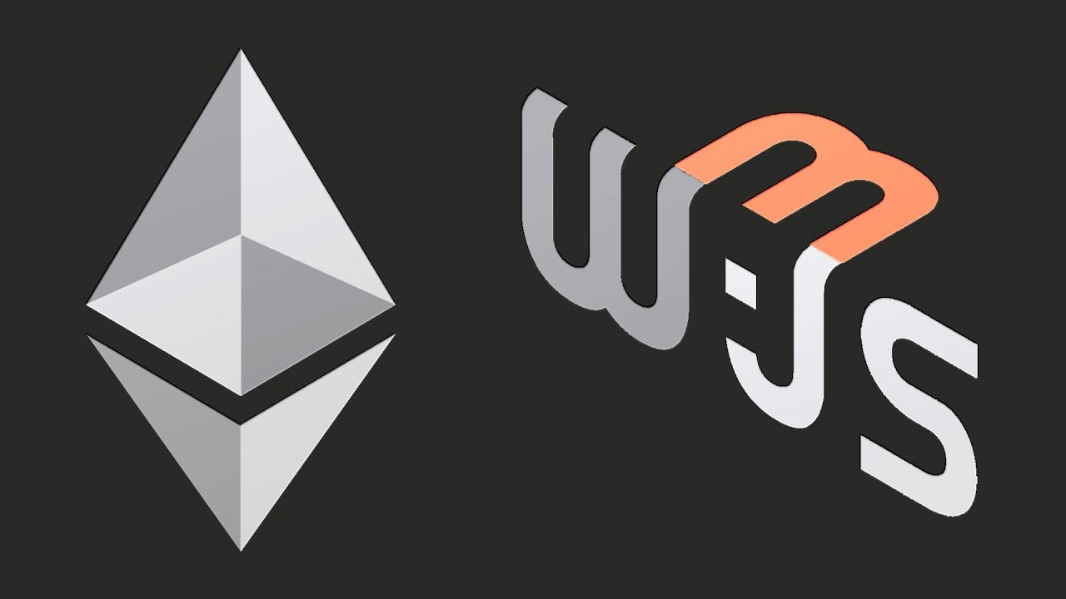
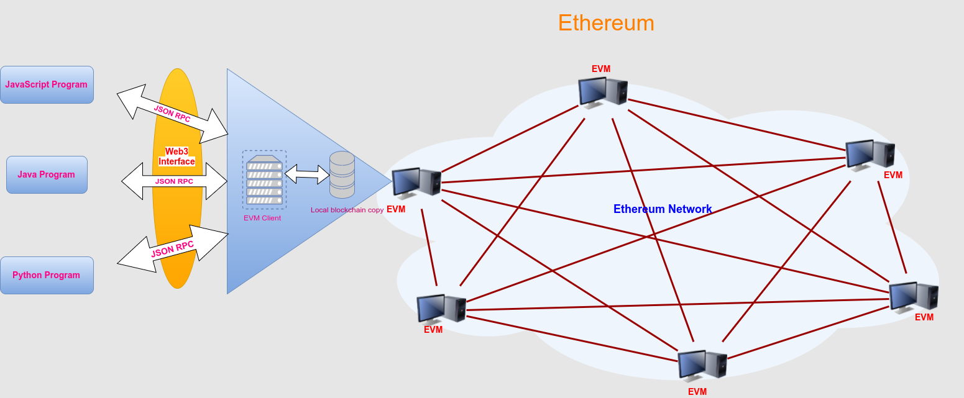

Slide 4
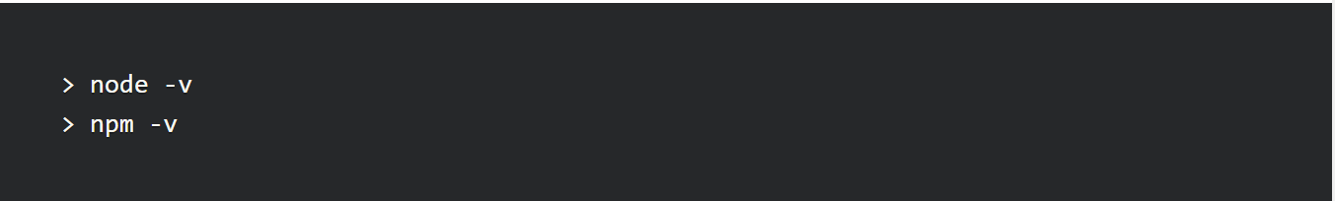
Installation steps
It is based on Node.js, we need Node.js installed along with NPM (Node Package Manager) to install it.
open up your command line or console and run the following 2 commands:
run the npm init command to create a package.json file, which will store project dependencies:
run the following command to install web3.js:

Slide 5
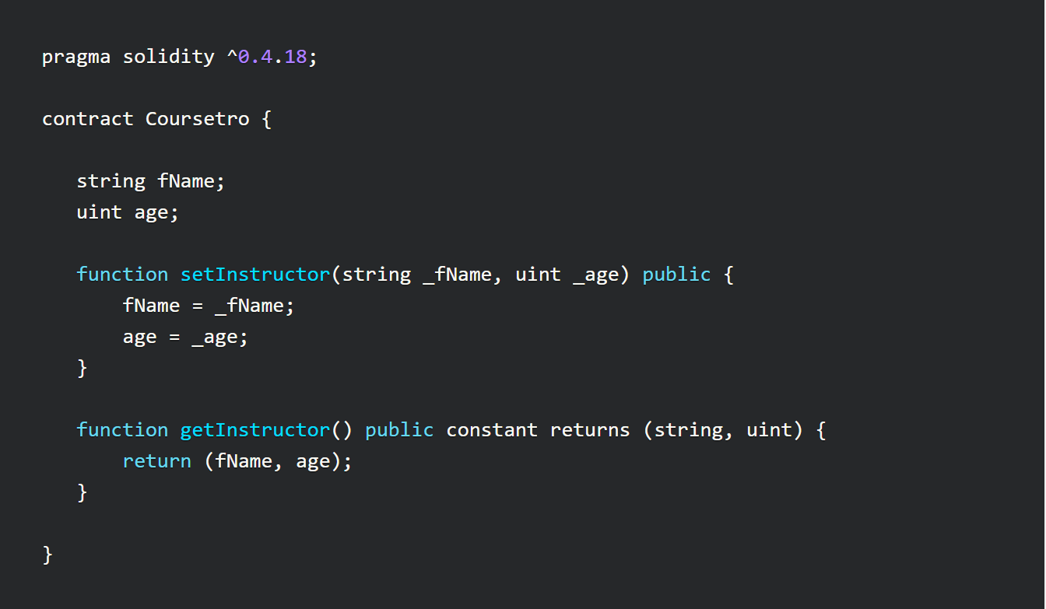
SMART Contract example in solidity

Slide 6
Remix
Web solidity Ide

Slide 7
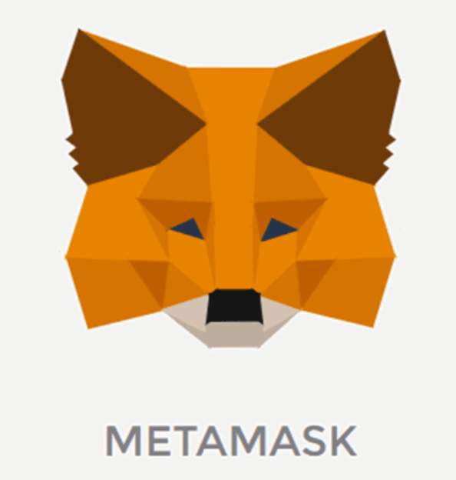
MetaMask is the easiest way to interact with dapps in a browser. It is an extension for Chrome or Firefox that connects to an Ethereum network without running a full node on the browser's machine. It can connect to the main Ethereum network, any of the testnets (Ropsten, Kovan, and Rinkeby), or a local blockchain such as the one created by Ganache or Truffle Develop.
Installing MetaMask
Chrome
Chrome Web Store
Firefox
Firefox Add-ons page

Slide 8
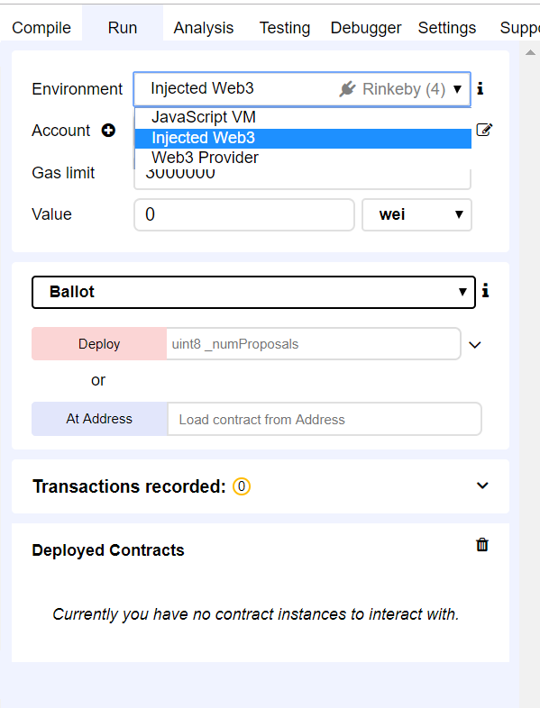
Changing the Environment in Remix
Switch over to the Remix IDE, click on the Run tab, and then change the Environment dropdown from Javascript VM to Injected Web3 to integrate the metamask wallet.

Slide 9
Next steps:
Click on the Compile tab and click Details. Scroll down until you see the Interface - ABI section and click the copy icon
Deploy the contract and save the address at which the contact is deployed.
These two things will be required when we interact with our smart contract using web3.js

Slide 10
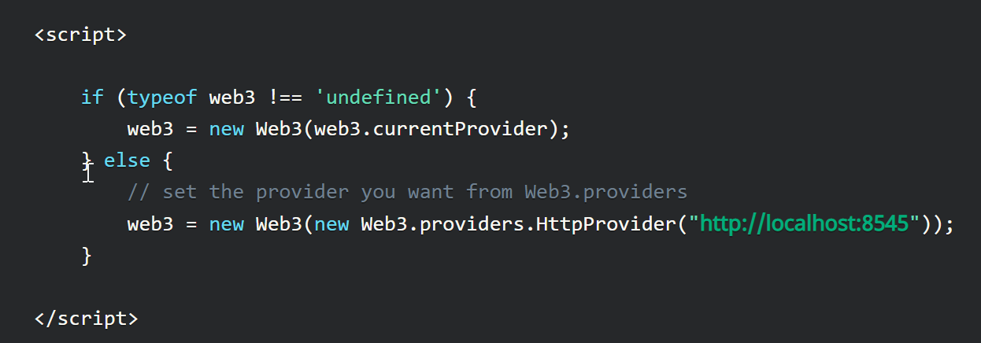
Using Web3.js to Connect & Interact with the Smart Contract
Instantiate a Web3 Connection like this :
Note :- The Metamask provider will be injected automatically when the application deployed on a server.

Slide 11
ContinueD. . .
2. Specify a default Ethereum account to use through the web3.eth.defaultAccount method.
3. web3.eth.contract() method to initialize the contract on an address. It accepts one parameter, which is referred to as the ABI (Application Binary Interface).
This ABI allows you to call functions and receive data from your smart contract.

Slide 12
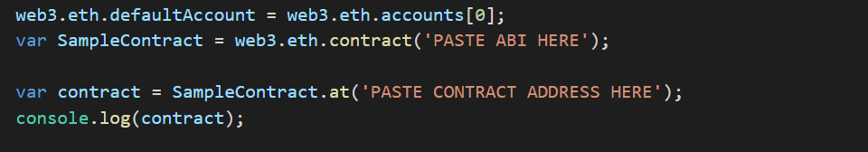
ContinueD . . .
4. Now, the actual contract instance can be found using the at () method:-

Slide 13
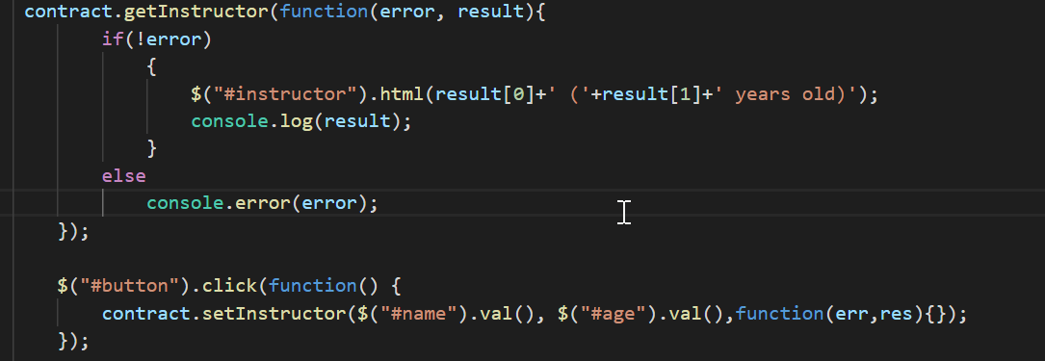
ContinueD . . .
5. Now, the call to methods of smart contract will be done with the help of callbacks methods

Slide 14
ContinueD . . .
Running index.html directly in browser will not detect the Web3 current provider.
Install local http-server with the following steps :-
Have Node.js installed in your system.
In CMD, run the command install http-server –g
Navigate to the specific path of your file folder in CMD and run the command http-server
Go to your browser and type localhost:8080. Your Application should run there.

Slide 15

LET’S GET STARTED

Slide 16
PREPARING THE UI

Slide 17
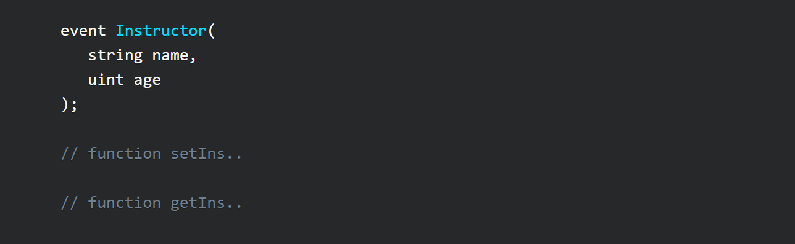
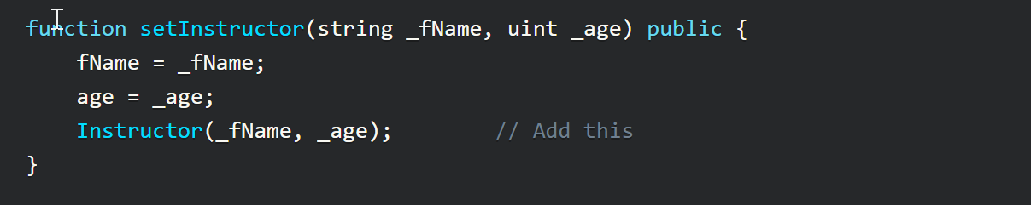
Smart Contract Events with Web3.js
Update the smart contract to add an event and call it in our method : -

Slide 18
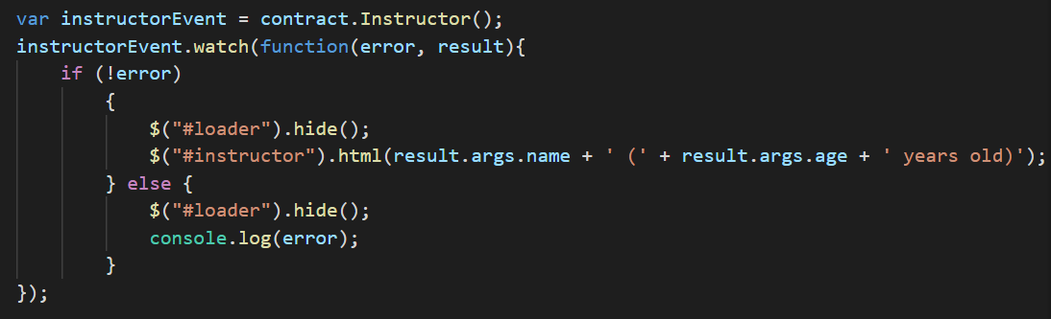
Continued . . .
2. No longer need to call Instructor.getInstructor(), instead create a variable to reference our event.
3. We're going to use the .watch() method on instructorEvent with a callback.
Note : - Remember to use the Remix IDE to deploy the updated contract, copy and paste the ABI along with the new smart contract address.

Slide 19
QUICK DEMO

Slide 20
Reading Materials
https://solidity.readthedocs.io/
https://remix.readthedocs.io/en/stable/
https://web3js.readthedocs.io/en/1.0/getting-started.html
https://github.com/MetaMask/faq/blob/master/DEVELOPERS.md#dizzy-all-async---think-of-metamask-as-a-light-client

